Slide 1
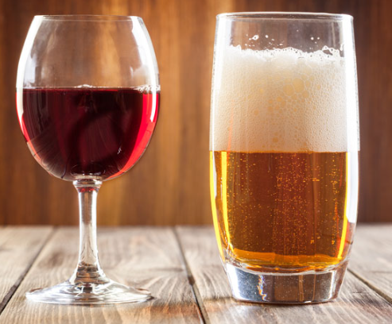

Project 3: Web APIs and NLP
Anand Ramchandani

Slide 2

Problem Statement
Collect posts from 2 subreddits and use NLP to train a classifier to distinguish between posts from the subreddits 'r/beer' and 'r/wine'

Slide 3
Plan to Achieve Project Goals
Gather data using Reddit's API
Clean Data
Data Exploration
Identify relevant features and conduct feature engineering
Vectorize using CountVectorizer and TF-IDF
Modelling using Logistic Regression, Multinomial Naive Bayes and Random Forest
Refinements and Hyper Parameter Tuning
Re-evaluate and select best model

Slide 4
REASON FOR CHOICE
Both are commonly consumed alcoholic beverages
Both have passionate followings
Both have lower alcohol %
Similar words (bottle, taste, etc.)
Different enough to allow for classification, similar enough to be challenging

Slide 5
BUSINESS RELEVANCE
Aid search engines in identifying between the 2 beverages
Model could be used for businesses sorting out/filtering email/queries/feedback
Example - Could be used to see how successful a marketing campaign was by filtering online comments after beer or wine commercial airs

Slide 6
Data Extraction/ Web Scraping
Downloaded user posts and comments using pushshift.io Reddit API
Identified urls
Called API
Converted API output to .json
Gathered 1,000 posts per subreddit

Slide 7
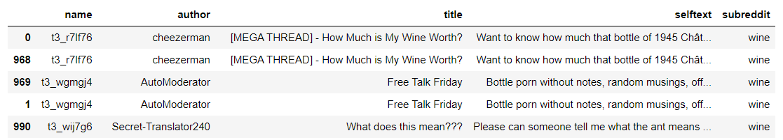
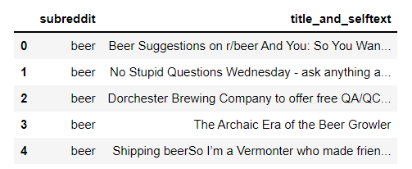
Data Cleaning / Feature Engineering
Check for duplicates and remove them
Check for null values
Merge title and selftext posts into 1 column (this also addressed a lot of missing data seen in selftext)

Slide 8
Data Cleaning – Pre Modelling Cleaning
Make text lowercase
Remove HTML special entities
Remove Hyperlinks
Remove Punctuation
Split 's, 't, ‘ve
Remove whitespace
Remove characters beyond Basic Multilingual Plane (BMP) of Unicode
Removal of Stop Words

Slide 9
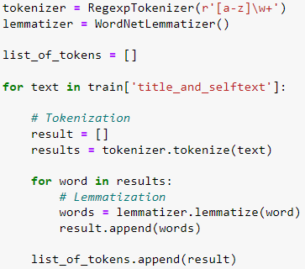
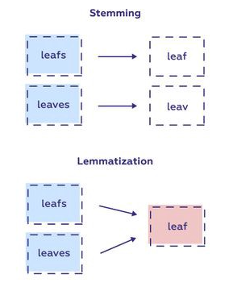
Tokenization and Lemmatization
Using this method to shorten root words and remove redundancy

Slide 10
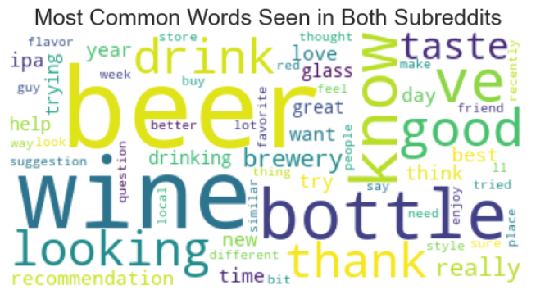
Word Cloud – Common Words Seen in Both Subreddits

Slide 11
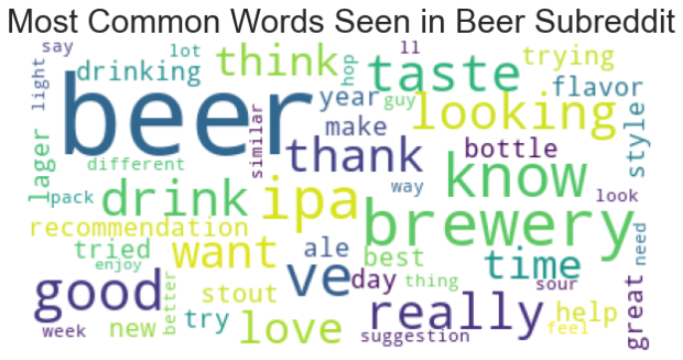
Word Cloud – Common Words Seen in Beer Subreddits

Slide 12
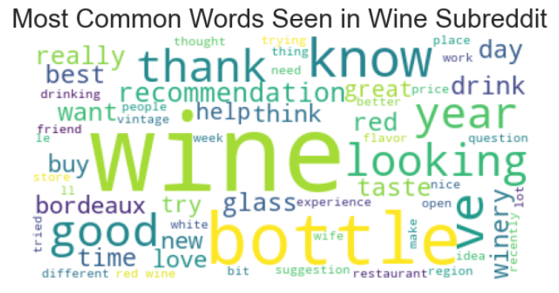
Word Cloud – Common Words Seen in Wine Subreddits

Slide 13
Data Modelling Plan
Models Used
Logistic Regression
Multinomial Naïve Bayes
Random Forest
Vectorizers used
CountVectorizer
TF-IDF Vectorizer
Compared the following Models:
Model 1: CountVectorizer with Logistic Regression
Model 2: CountVectorizer with MultinomialNB
Model 3: CountVectorizer with Random Forest
Model 4: TF-IDF Vectorizer with Logistic Regression
Model 5: TF-IDF Vectorizer with MultinomialNB
Model 6: TF-IDF Vectorizer with Random Forest

Slide 14
Data Modelling Plan – How to analyse Models selected
Conduct GridSearch CV (pipe vectorizer with model chosen)
Evaluate accuracy score and prediction on test data set
Re-evaluate after Hyperparameter Tuning
Draw Confusion Matrix
Calculate Sensitivity, Specificity, Precision
Draw ROC curve
Make evaluation of which model is best

Slide 15
Model Evaluation
Comparison of Models based on Accuracy and AUC Score on Test Data
 | CountVectorizer |  |  |  | TF-IDF
 | Accuracy (Train) | Accuracy (Test) | % | ROC-AUC Score (Test) | Accuracy (Train) | Accuracy (Test) | % | ROC-AUC Score (Test)
Logistic Regression | 0.9987 | 0.9644 | 3.5035 | 0.99 | 0.9885 | 0.9585 | 3.0290 | 1
Multinomial Naïve-Bayes | 0.9936 | 0.9663 | 2.7460 | 0.99 | 0.9834 | 0.9585 | 2.5246 | 0.99
Random Forest | 1.0000 | 0.9508 | 4.9223 | 0.98 | 1.0000 | 0.9611 | 3.8860 | 0.98

Slide 16
Model Evaluation
Comparison of Models based on Sensitivity, Specificity and Precision
 | CountVectorizer |  |  | TF-IDF
 | Sensitivity | Specificity | Precision | Sensitivity | Specificity | Precision
Logistic Regression | 0.938 | 0.982 | 0.974 | 0.925 | 0.982 | 0.974
Multinomial Naïve-Bayes | 0.969 | 0.965 | 0.951 | 0.944 | 0.969 | 0.956
Random Forest | 0.931 | 0.987 | 0.98 | 0.931 | 0.982 | 0.974
Choose Sensitivity/Recall if the idea of false positives is far better than false negatives
Choose Precision if you want to be more confident of your true positives
Choose Specificity if you want to cover all true negatives, meaning you don’t want any false alarms, you don’t want any false positives

Slide 17
CountVectorizer with Logistic Regression – Model Chosen
Reason for choice:
Good Accuracy (Test) Score - 0.9644
0.99 – Good ROC-AUC Score
Precision would best suit our needs and the model has 0.974 precision

Slide 18
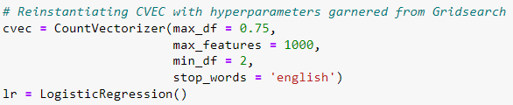
Hyperparameters used for CountVectorizer with Logistic Regression

Slide 19
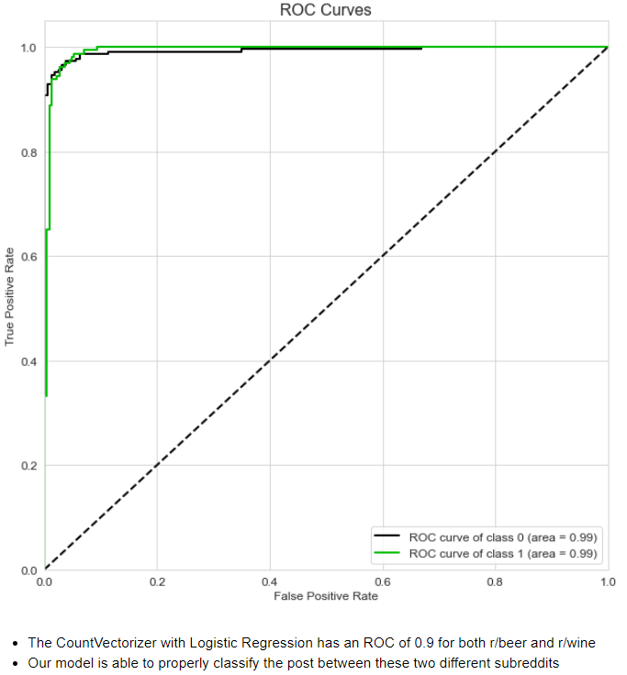
ROC Curve - CountVectorizer with Logistic Regression

Slide 20
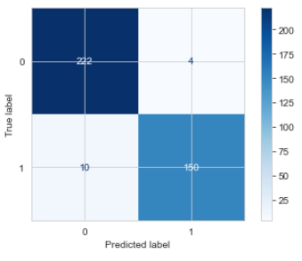

Confusion Matrix - CountVectorizer with Logistic Regression

Slide 21
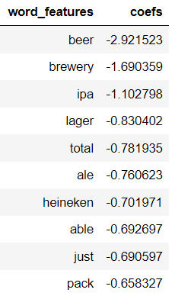
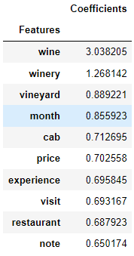
Feature Importance in r/beer and r/wine - CountVectorizer with Logistic Regression

Slide 22
Conclusions
CountVectorizer with Logistic Regression chosen as most apt model for our classification purposes
Key words between the 2 subreddits help immensely in message classification
Differences outweigh similarities
Can be a useful tool to aid marketing or strategy
Model works well but will fail if message is too general

Slide 23
Recommendations
Improve removal of noise words
Try more models
Collect more training data
Can do more data cleaning (e.g. increase number of stop words)
Better Gridsearching methods to optimize model selection
May not be as accurate in long run if new words used
We could test this model on similar alcohol subreddits like whiskey, gin, vodka etc.

Slide 24
Thanks for listening!
Any questions?

